Slide 1


Bank of Baroda Hackathon - 2022
Technology Partner
Your Team Name : VADS
Your team bio :Stabbing action detection in ATM Kiosks– Academia (4 Members)
Research Interest: Video Analytics
Published Papers: 60
Industry Project Completed: 2
Date : 20.09.2022

Slide 2
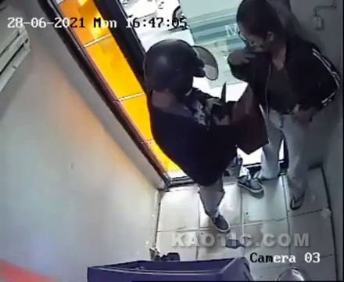
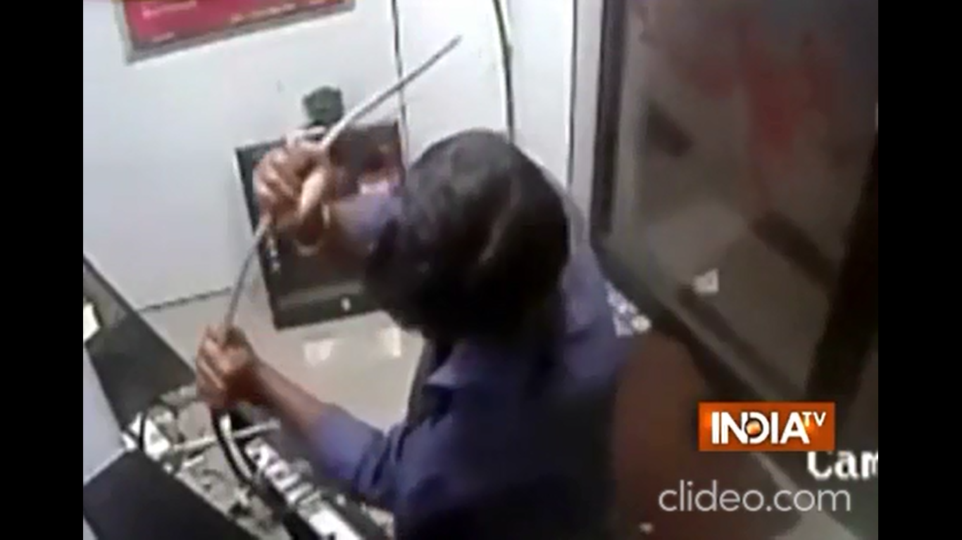
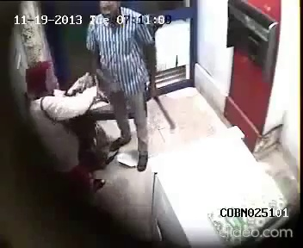
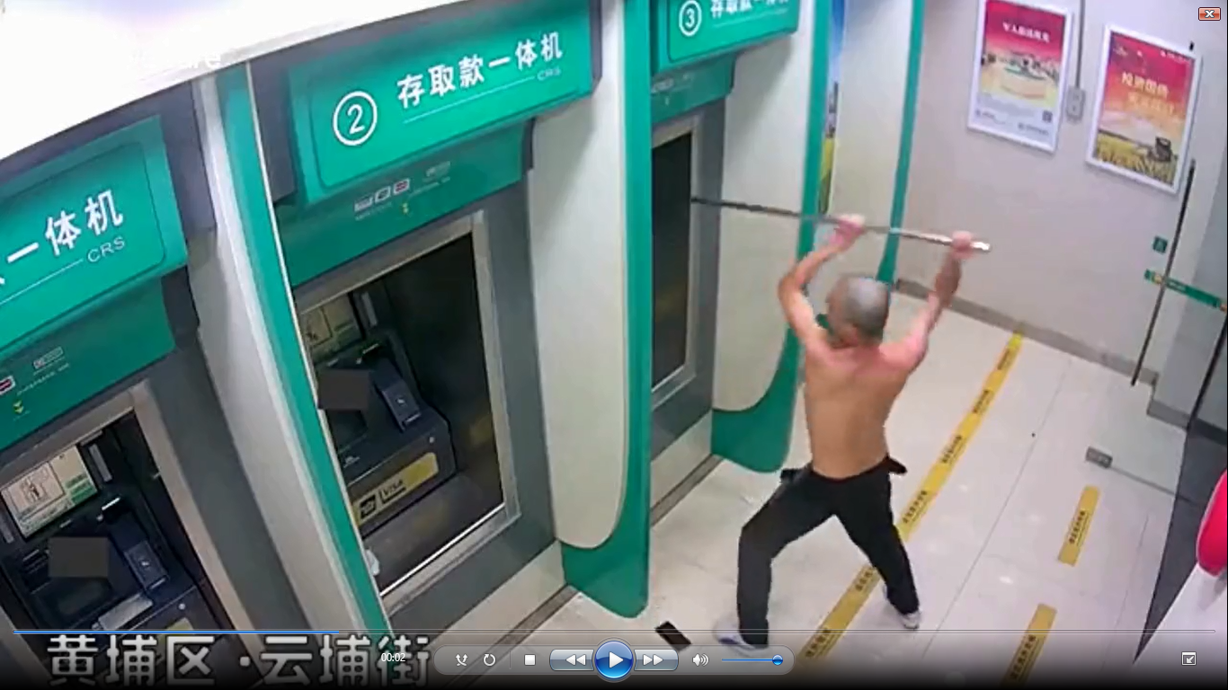
Problem Statement: Any activity that needs attention
Abnormal Activity: Stabbing Attack at ATM Kiosks and Banks
Carrying weapons inside ATM and bank premises is an abnormal activity.
An assailant can attack a customer/ bank employee or damage the ATM kiosks using knife, sickle, hammer, crowbar/digging bar and Gun which needs attention to prevent the crimes and increase the safety.
Real-World CCTV footages collected from various resources (India and Global)
Samples of such violent events happened are: Bangalore ATM footage (2013) (https://www.youtube.com/watch?v=anVFC81_mtc) and China ATM footage () (https://youtu.be/Yw-Apx06xrk).
It is very challenging to detect such stabbing attacks in a restricted environment like ATM and Banks.
Hence, the aim of the proposed system is to develop an Intelligent video analytics for ATM surveillance applications for detecting the stabbing action happening inside the ATM.

Slide 3
User Segment & Pain Points
Which user /advertiser segment would be early adopter of your product & why?
Bank sectors (Public/Private) – To prevent the crime and increase the safety of customers
Law and Order (Crime Investigation) – Evidence as well as alarm can be made at the right time.
Reason:
Customer safety is very important – At right time the alarm
Finance is also to be handled safely

Slide 4
Pre-Requisite
What are the alternatives/competitive products for the problem you are solving?
Inside the city, the control is possible y the securities. Areas beyond the city-limit, we can not monitor 24X7. Even the securities are attacked by the stabbers.
As per our knowledge, no surveillance products are there with the automated stabbing action alert system.
We have published one paper in CVIP 2020. (Prototype -1) – GMM+YOLOv3/YOLOv5+Lucas Kanade Motion estimation framewwork
Research towards complex activities such as, a person stabbing with a knife, a person shooting with a Gun are budding.

Slide 5
Azure tools or resources
Azure tools or resources which are likely to be used by you for the prototype, if your idea gets selected We have developed using Python. We have used customvision-object detection model from the Azure resources. Prediction API: To use Image url: https://bobvads-prediction.cognitiveservices.azure.com/customvision/v3.0/Prediction/d06d966a-c9d7-45ac-89af-5ff81f78ef37/detect/iterations/Iteration4/url To use image file : https://bobvads-prediction.cognitiveservices.azure.com/customvision/v3.0/Prediction/d06d966a-c9d7-45ac-89af-5ff81f78ef37/detect/iterations/Iteration4/image

Slide 6
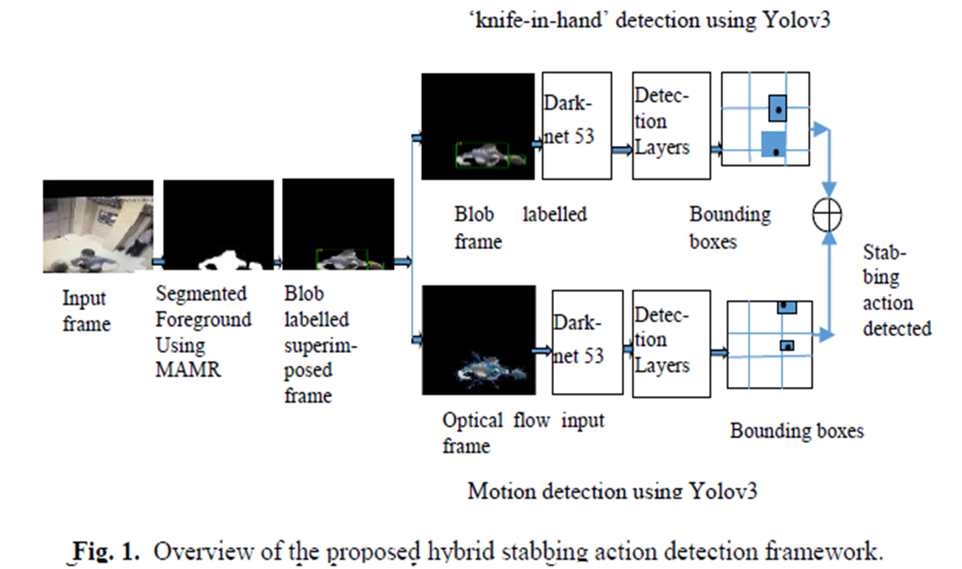
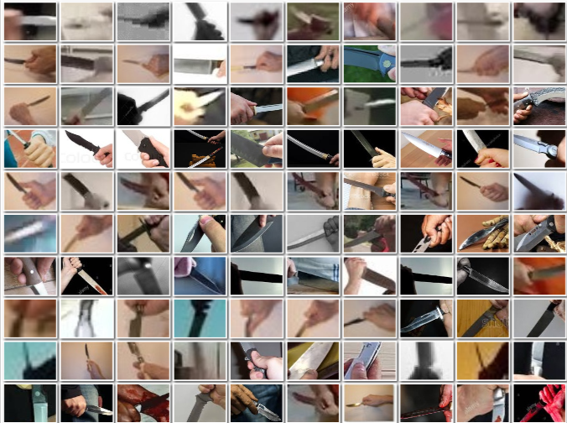
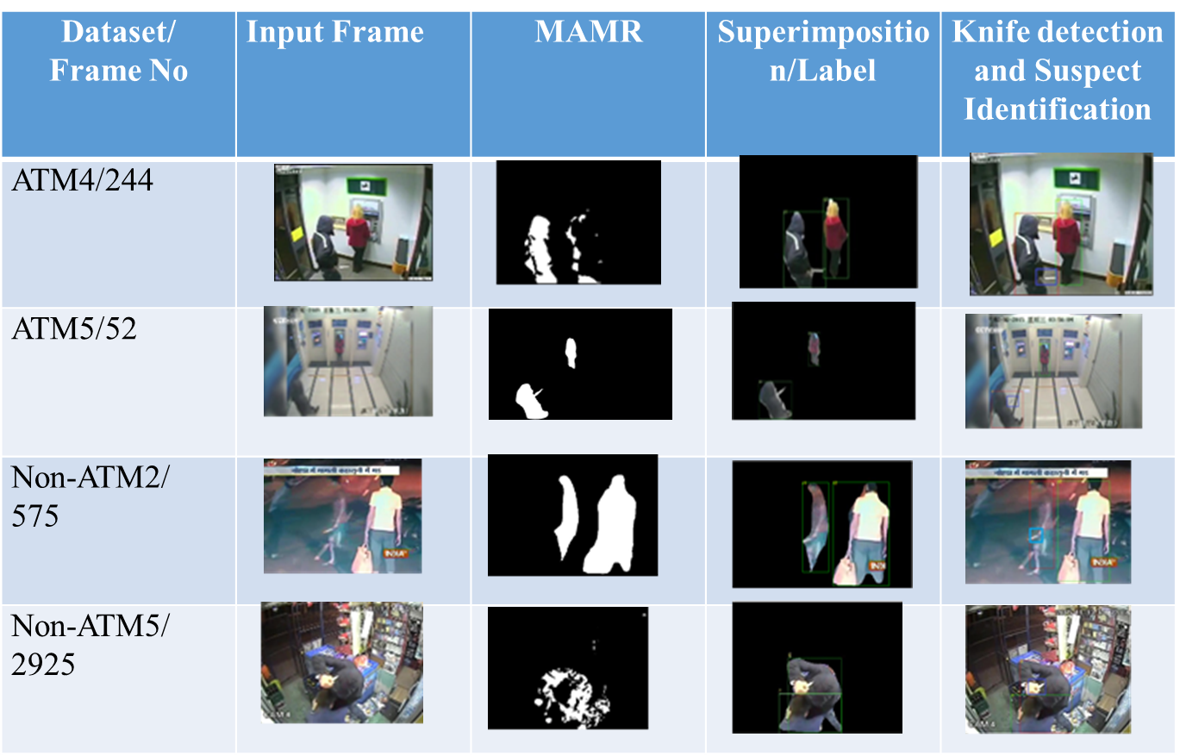
Any Supporting Functional Documents
Present your solution, talk about methodology, architecture & scalability
Various Conditions | Training Images for knife in hand detection
Target (Blurred)
Targeting Left
Targeting Right
Targeting Obtuse
Targeting Obtuse (Blurred)
Targeting Reflex (Blurred)
Targeting Reflex
Targeting Downwards
Targeting Upwards
Target (Blur, Excess Blur and Normal)
Fig. 1. Overview of the proposed hybrid stabbing action detection framework.
Fig. 2. Training images of ‘knife-in-hand’ acquired in challenging environments

Slide 7
Stabbing Action Detection in ATM Kiosks
A societal conscious framework

Slide 8
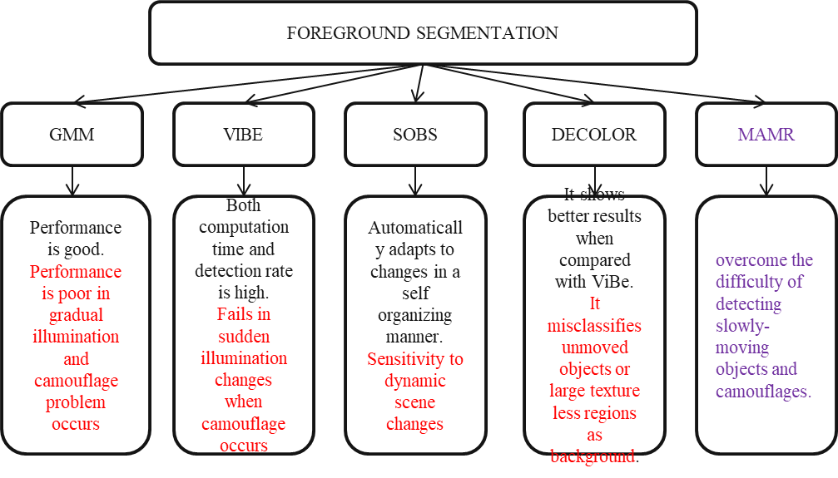
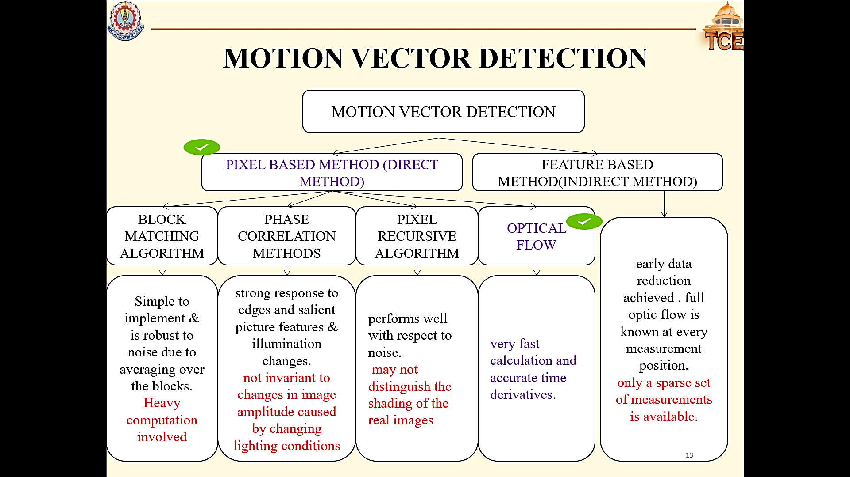
Key Differentiators & Adoption Plan
How is your solution better than alternatives and how do you plan to build adoption?

Slide 9
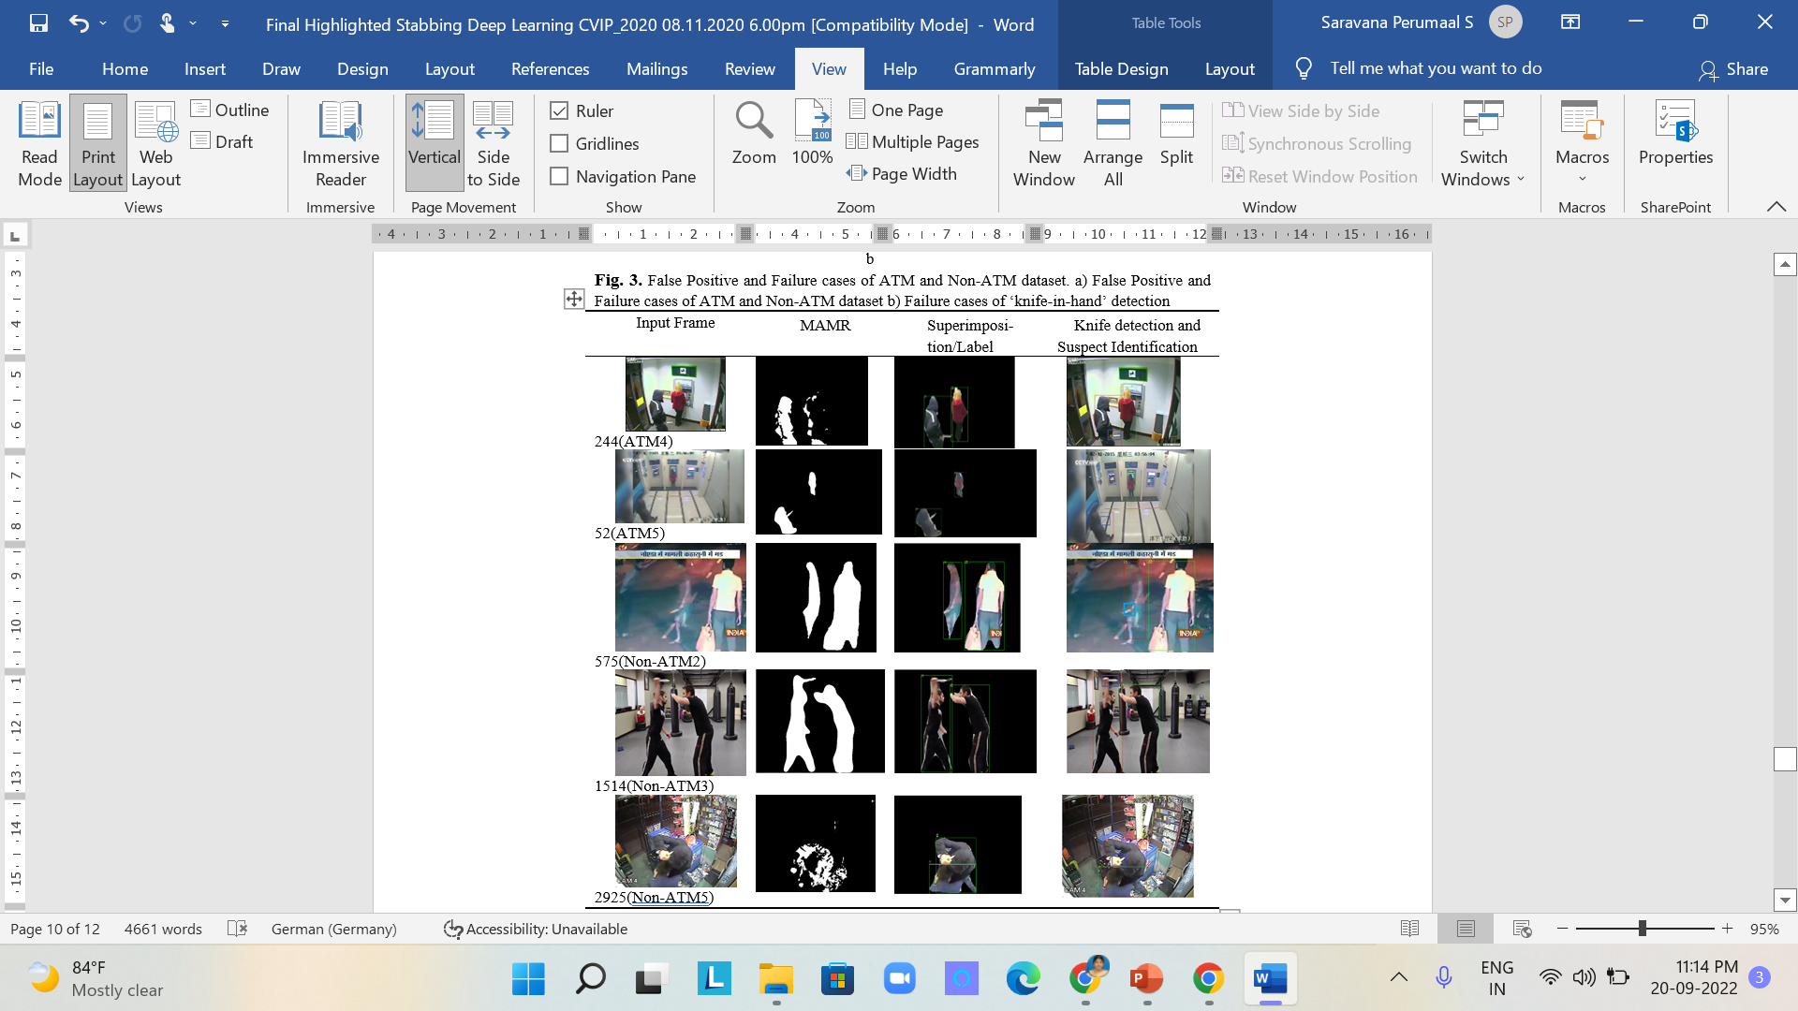
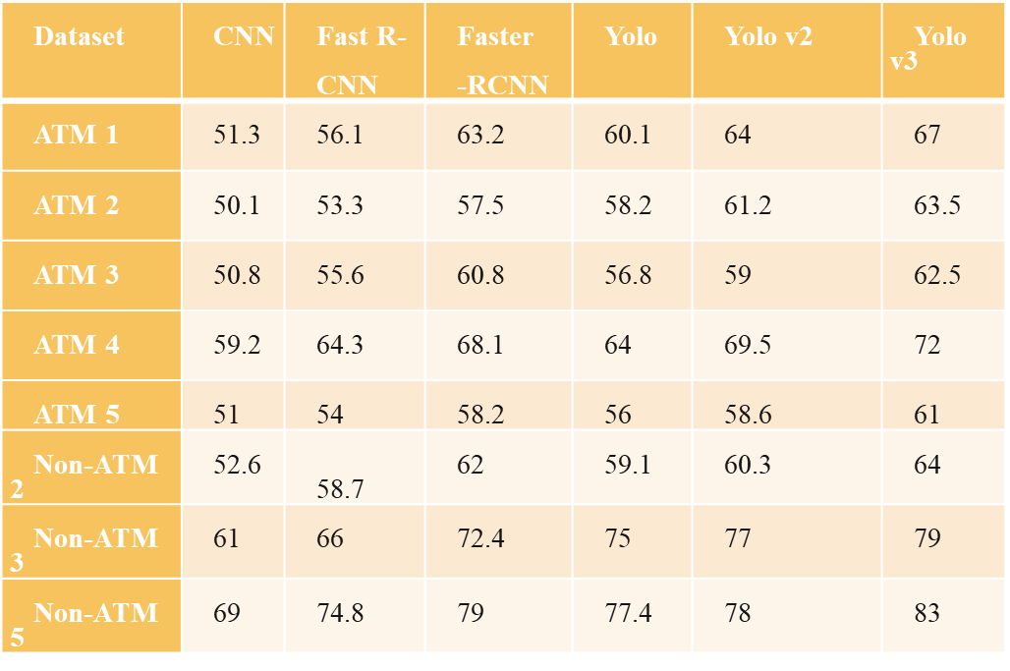
GitHub Repository Link & supporting diagrams, screenshots, if any
How far it can go?
It can be extended using YOLO v5 and YOLO v7 to improve the accuracy.
To reduce the false positives, we can improve the network architecture in each stage.
Table 2 mAP (%) of the ‘knife-in-hand’ detection using CNN, Fast R-CNN, Faster R-CNN(λ=10), Yolo, Yolo v2 and Yolo v3

Slide 10
Thank You
Team member names
Dr.B.Yogameena
Dr.K.Menaka
Ms. K.Iyshwarya Ratthi
Dr.S.Saravana Perumaal

